Slide 1
Bank Loan report

Slide 2
agenda
Objective of the analysis
Key Insights of the analysis
Summary Dashboard
Overview Dashboard

Slide 3
Objective of the Analysis
The Bank Loan Report project dives deep into monitoring and evaluating a bank's lending activities, providing comprehensive insights into loan- related metrics. This Excel dashboard aims to facilitate data-driven decision-making and strategic planning.

Slide 4
Key performance indicators
Total Loan Application
we need to calculate the total number of loan applications received during a specified period. Additionally, it is essential to monitor the Month-to-Date (MTD) Loan Applications and track changes Month-over-Month (MoM).
Total Funded Amount
Total Amount Received
Average Interest Rate
Average Debt-to-income Ratio
Evaluating the average DTI for our borrowers helps us gauge their financial health.

Slide 5
Good Loan V/S BAD LOAN
Summary Dashboard
Good Loan Application Percentage
Good Loan Applications
Good Loan Funded Amount
Good Loan Total Received Amount
Bad Loan Application Percentage
Bad Loan Applications
Bad Loan Funded Amount
Bad Loan Total Received Amount
In order to gain a comprehensive overview of our lending operations and monitor the performance of loans, we aim to create a grid view report categorized by 'Loan Status’.

Slide 6
Overview dashboard Charts
Monthly Trends by Issue Date (Line Chart): To identify seasonality and long-term trends in lending Activities.
Regional Analysis by State (Filled Map): To identify regions with significant lending activity and assess regional disparities.
Loan Term Analysis (Donut Chart): To allow the client to understand the distribution of loans across various term lengths.
Employee Length Analysis (Bar Chart): How lending metrics are distributed among borrowers with different employment lengths, helping us assess the impact of employment history on loan applications.
Loan Purpose Breakdown (Bar Chart): Will provide a visual breakdown of loan metrics based on the stated purposes of loans, aiding in the understanding of the primary reasons borrowers seek financing.
Home Ownership Analysis (Tree Map): For a hierarchical view of how home ownership impacts loan applications and disbursements.

Slide 7
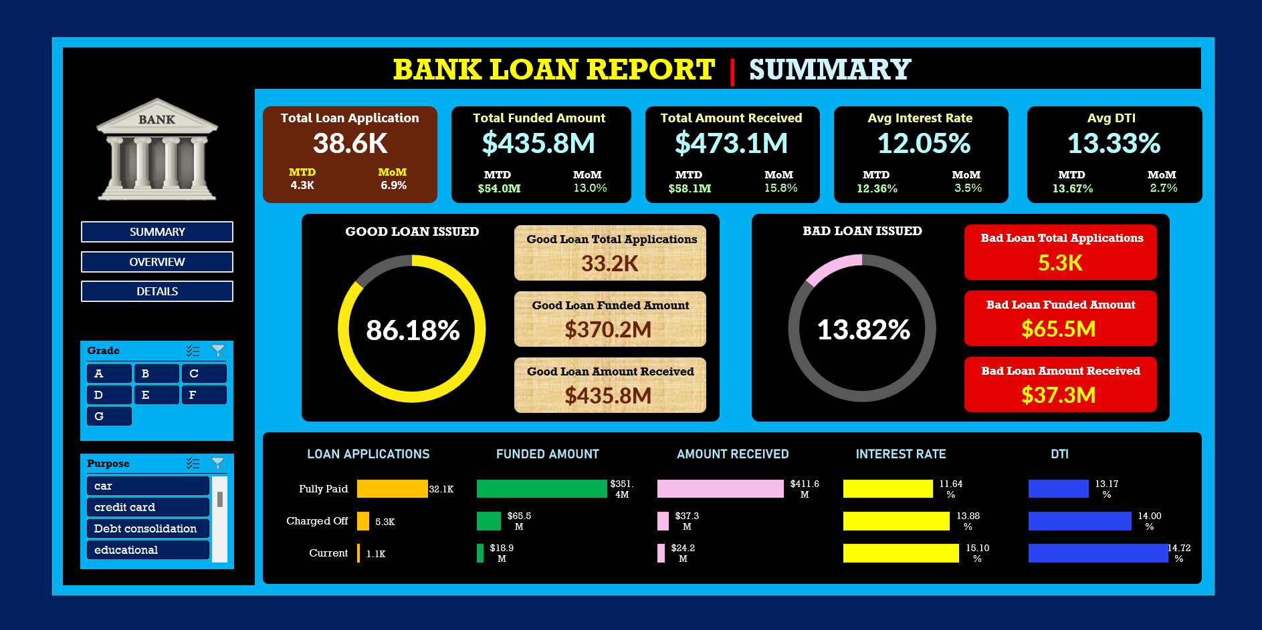
Summary Dashboard

Slide 8
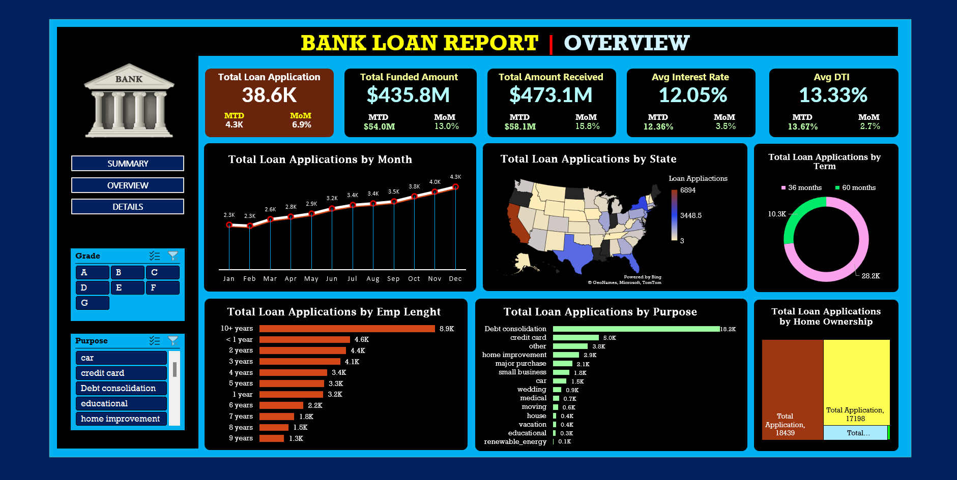
Overview dashboard

Slide 9
Thank you
NAGENDRA V KINI

